Slide 1
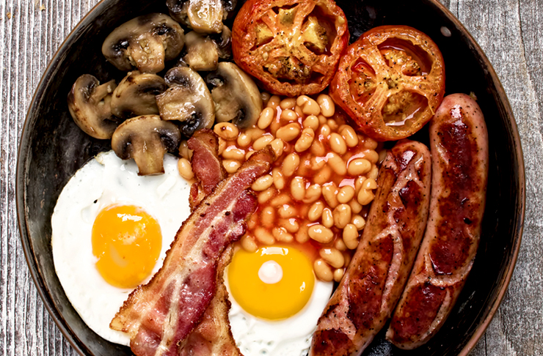
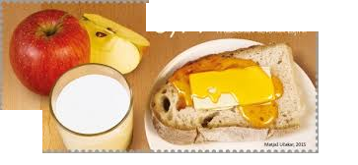
GOOD MORNING!
BREAKFAST
SLOVENIAN BREAKFAST
ENGLISH BREAKFAST

Slide 2
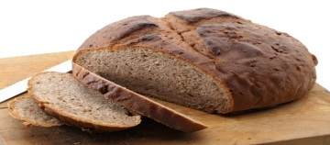
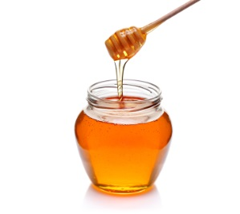
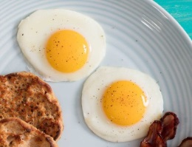
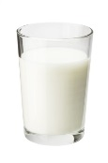
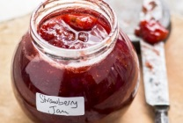
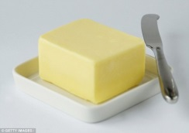
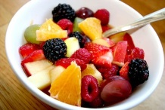
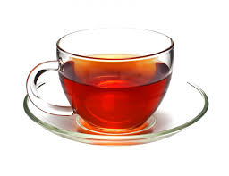
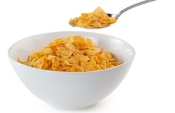
What can you eat and drink for breakfast?
Kaj lahko ješ in piješ za zajtrk?
bread
milk
honey
jam
fried eggs
butter
fruit
tea
cereal
orange juice

Slide 3
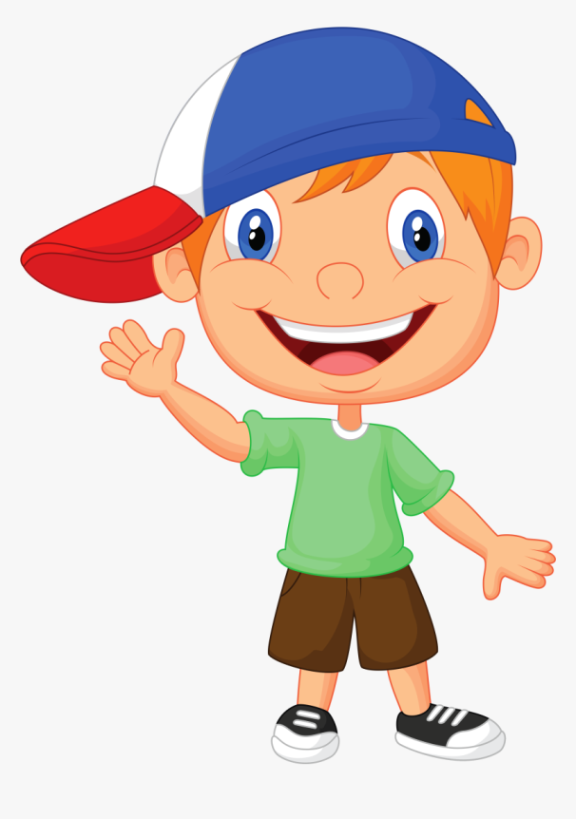
Good morning!
Good morning!
What would you like for breakfast today?
I would like fried eggs, bread and milk.

Slide 4
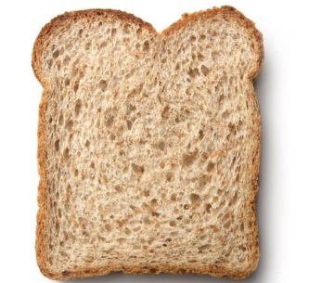
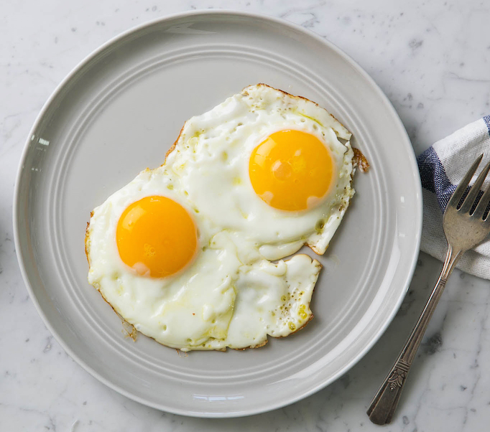
Here you go.
Thank you!
You‘re welcome.

Slide 5
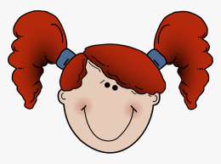
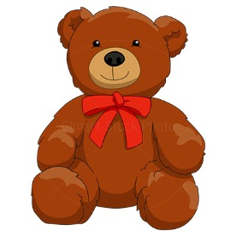
NOW LET‘S PLAY! Sedaj se pa igrajmo.
Vzami svojega najljubšega medvedka in mu pogrni mizo. Kot prej v dialogu
se z njim igraj. Ko igraš medvedka spremeni glas. Vsakič naj si zaželi nekaj
drugega za zajtrk. Namesto z medvedkom se lahko igraš s katerim od družinskih
članov.
Good morning! What would you like for breakfast today?
Good morning! I would like _____________________________.
Here you go.
Thank you!

