Slide 1
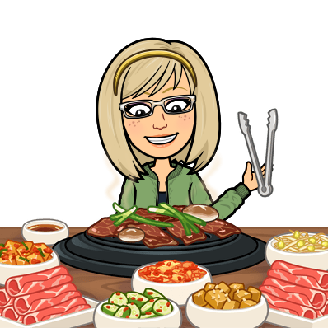
GOOD AFTERNOON!
LUNCH
What can you eat for lunch?
Kaj lahko ješ za kosilo?
To smo se že učili. Prelistaj zvezek
in ponovi.

Slide 2
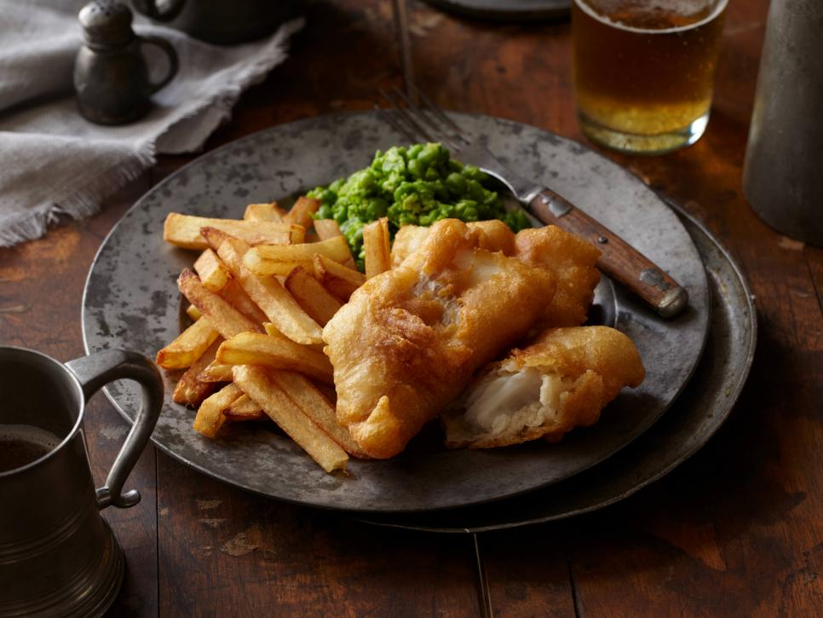
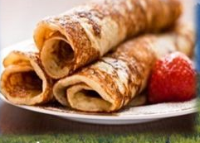
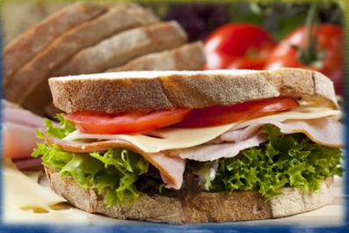
GOOD EVENING!
DINNER
SLOVENIAN DINNER
ENGLISH DINNER

Slide 3
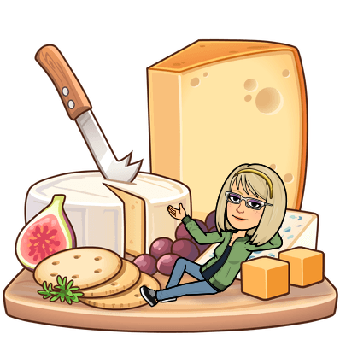
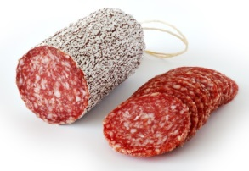
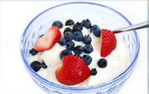
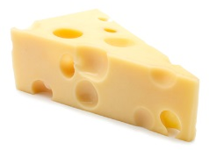
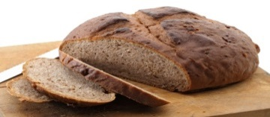
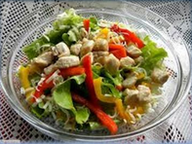
What can you eat for dinner?
Kaj lahko ješ za večerjo?
pancakes
salami
a yoghurt
cheese
bread
pickles
a sandwich
a salad

Slide 4
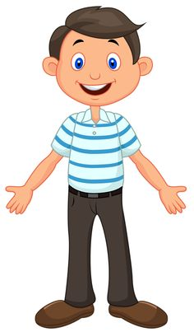
Good evening!
Good evening!
What would you like for dinner today?
I would like bread, salami cheese and pickles.

Slide 5
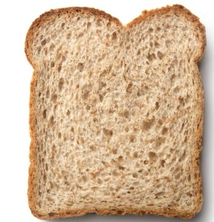
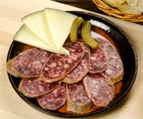
Here you go.
Thank you!
You‘re welcome.

